Slide 1
Halloween
The History of Halloween in Ireland

Slide 2
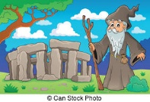
Years and Years ago
Two thousand years ago (2000) in the time of the Celts and Druids.
The new year in Ireland, France and Britain started on the 1st November.
At the end of summer after the harvest they burnt all the old wood and stalks in bonfires.

Slide 3
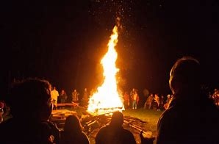
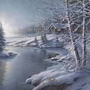
Druid/Celtic New Year
To celebrate the New Year the Druids built huge bonfires. This was called the Fire Festival.
The Druids and the people believed that the plants and animals and the Heavens were Gods for them.
They wore animal costumes and told each other’s fortunes.
The fires were let go out and the Druids re-lit them. Casting out the old (wood) and bringing in the new year.
Then they went home for the long dreaded winter.

Slide 4
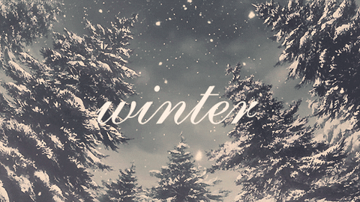
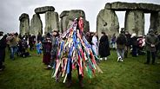
Why did Druids do this?
It was a way of signalling the year had ended.
The winters were long and hard. With little food and illnesses many people died over the winter. They had to store food and bring in the animals.
They also believed that the souls of the dead would return to their homes and play games on the living!
This religious ceremony was called Samhain.

Slide 5
Celtic New Year
It was called Samhain in Ireland.
It was called Samhuinn in Scotland.
It was called Sauin in The Isle of Man (Manx).
It was called Calan Gaeaf in Wales.
It was called Kala Goanv in Brittany (France.)

Slide 6
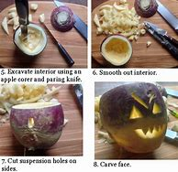
Turnips
In Britain the festival of Fire continued after Christianity was introduced.
People still burnt all the old garden rubbish and Farmers their stalks and rotting food.
Those in towns or cities carved out a Turnip and put a candle in it to help celebrate Halloween.

Slide 7
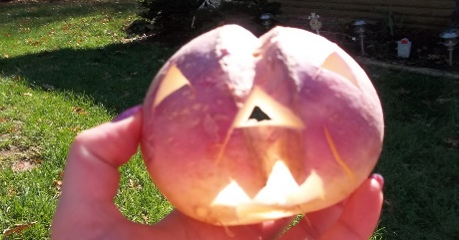
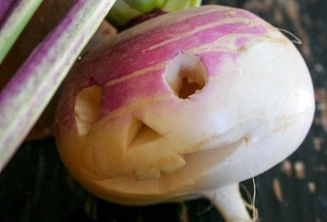
Jack o’lanterns
In Ireland and Scotland turnips, potatoes or beetroots were carved.
Why?
Myth:- Stingy Jack—originated in Ireland, and the Irish brought this celebration to America.
Jack invited the devil for a drink, however he tricked the Devil into changing into a coin to buy the drink. He trapped the devil by putting him with a cross. He later let the Devil go on condition he did not harm him.
The next year he tricked the devil again and used God to trap him, again. When Jack died God wouldn’t let him into Heaven and the Devil wouldn’t let him into Hell.
Jack had to wander the earth. He put a candle into a turnip and used this to light his way.

Slide 8
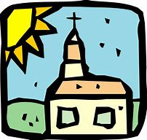
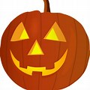
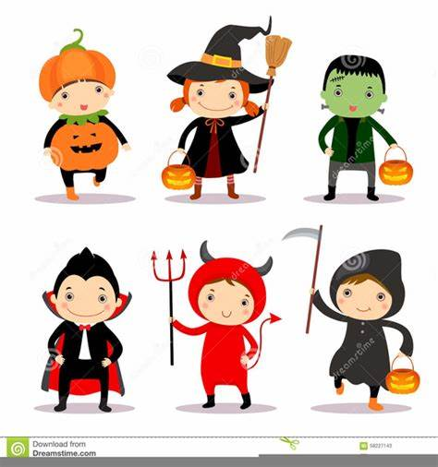
Christianity
The Christian Church took over the festival for All Saints Day.
People would have went to church to celebrate the Christian saints. 31st October was a Hallowed Evening ( Hallow’een). But still had bonfires.
Today, we carve Pumpkins (they came from Amercia and they are easier to carve).
People dress up either as evil spirits or animals. The old influence is still with us.

Slide 9
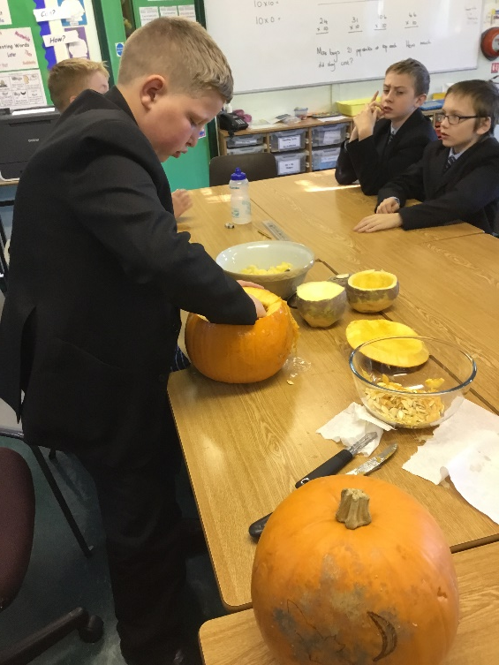
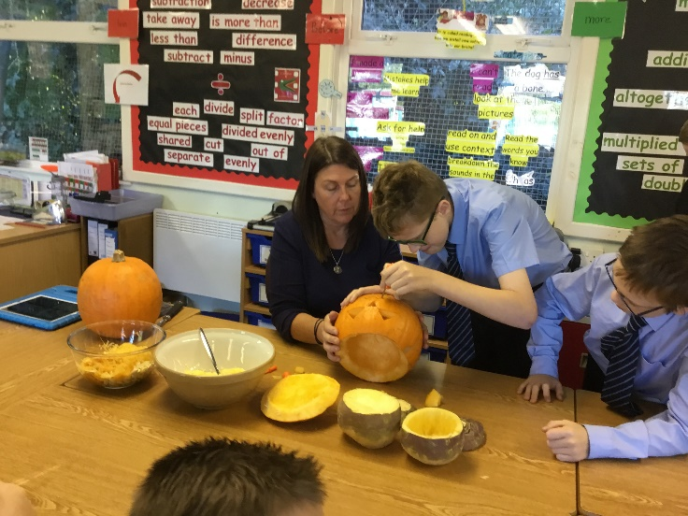
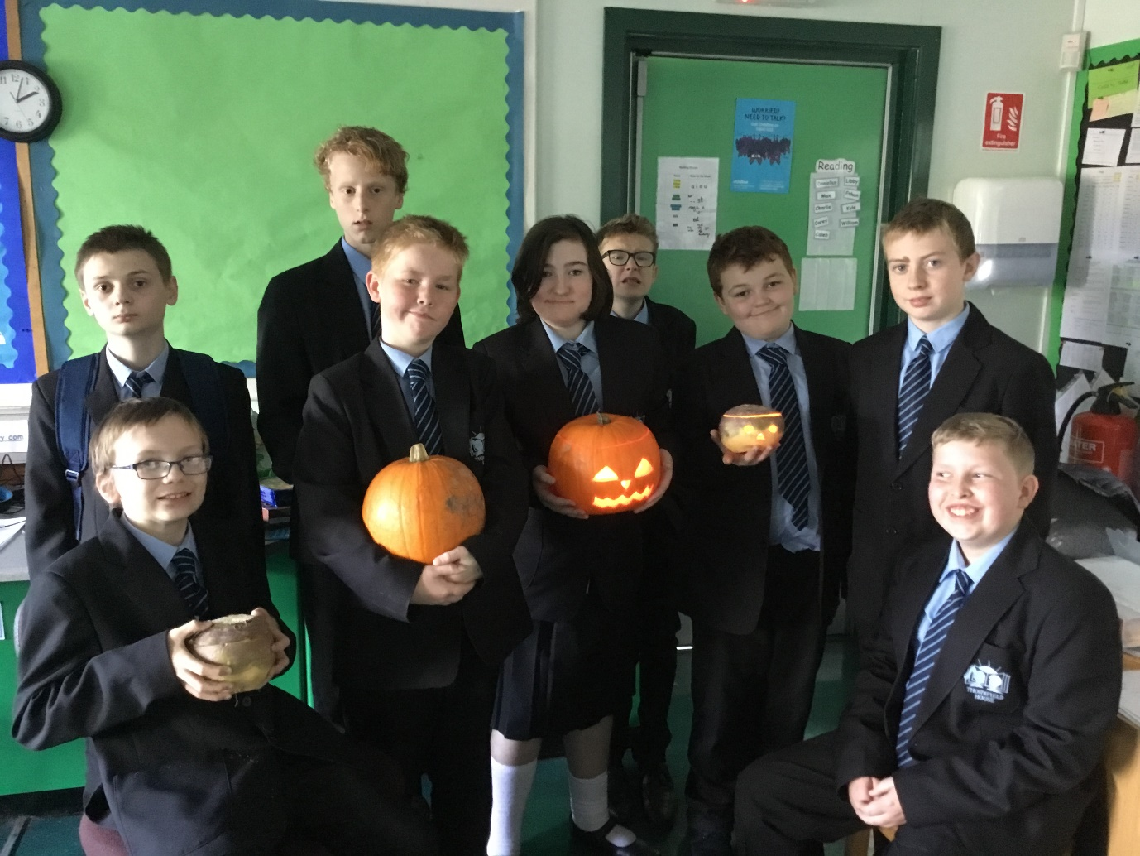
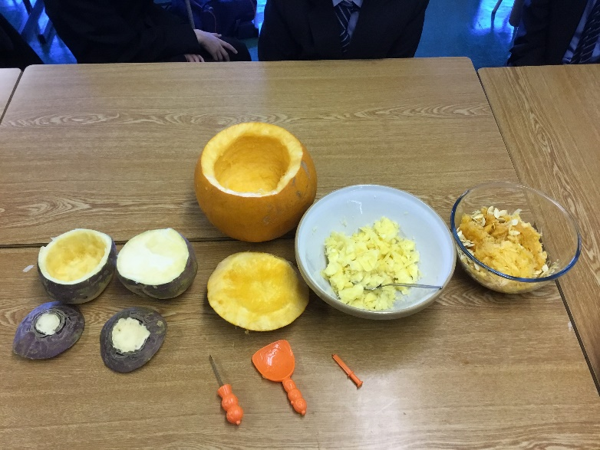
Pictures of us cutting a pumpkin
(turnip and pumpkin class photo)

Slide 10
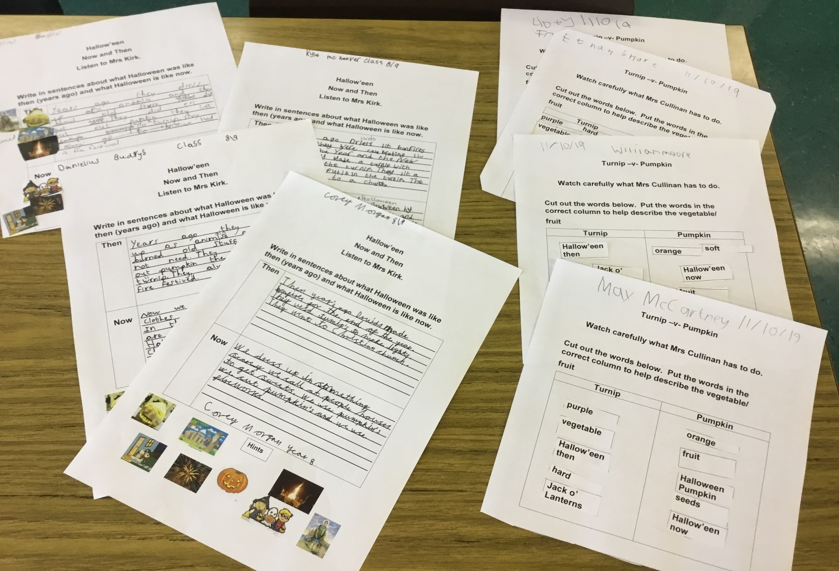
Some of our worksheets on the History of Halloween.

